Slide 1

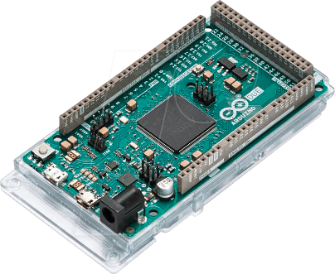


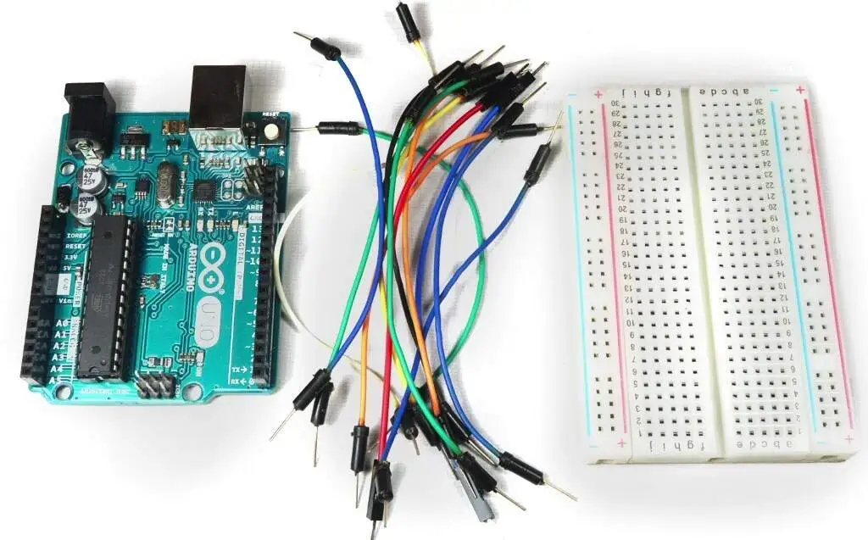
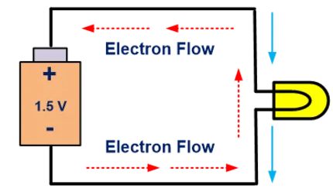
Circuits!!!!

Slide 2

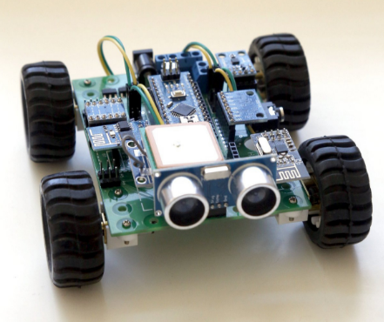
In JamCoders, so far: Software
Today: Hardware!

Slide 3

About Safety: Arduinos can’t hurt you.

Slide 4
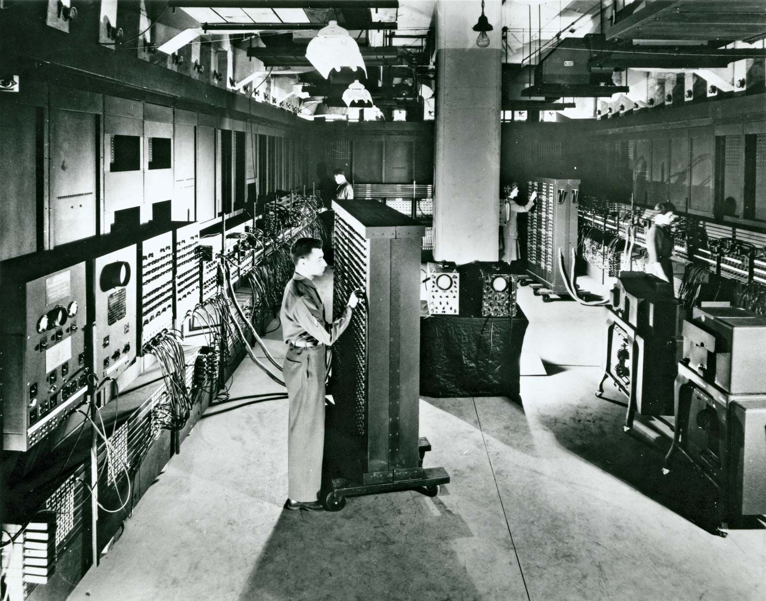

Electronic Numerical Integrator and Computer
(ENIAC)
Invented 1946
University of Pennsylvania (U Penn)
Notes:
Boaz and Orr
Size of 5 fridges

Slide 5
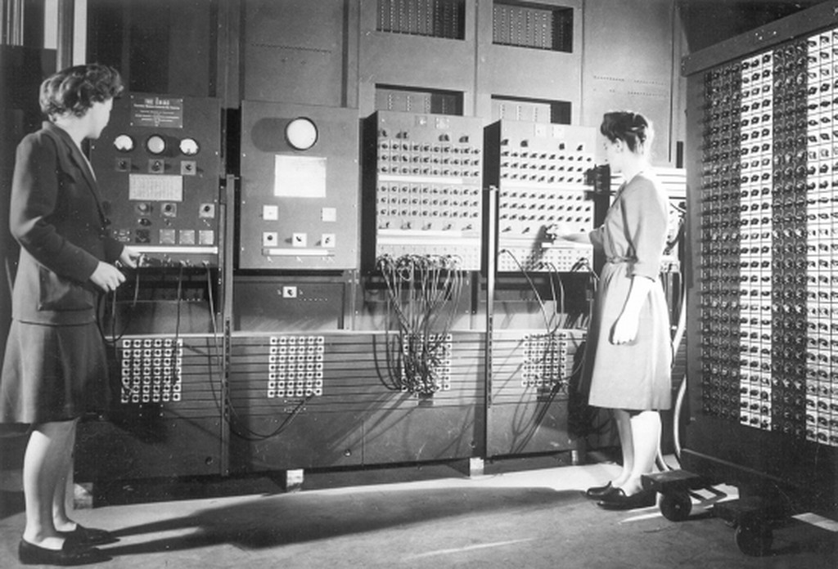

Electronic Numerical Integrator and Computer (ENIAC): 5000 calculations per second
M3Ultra: 36 trillion operations per second

Slide 6
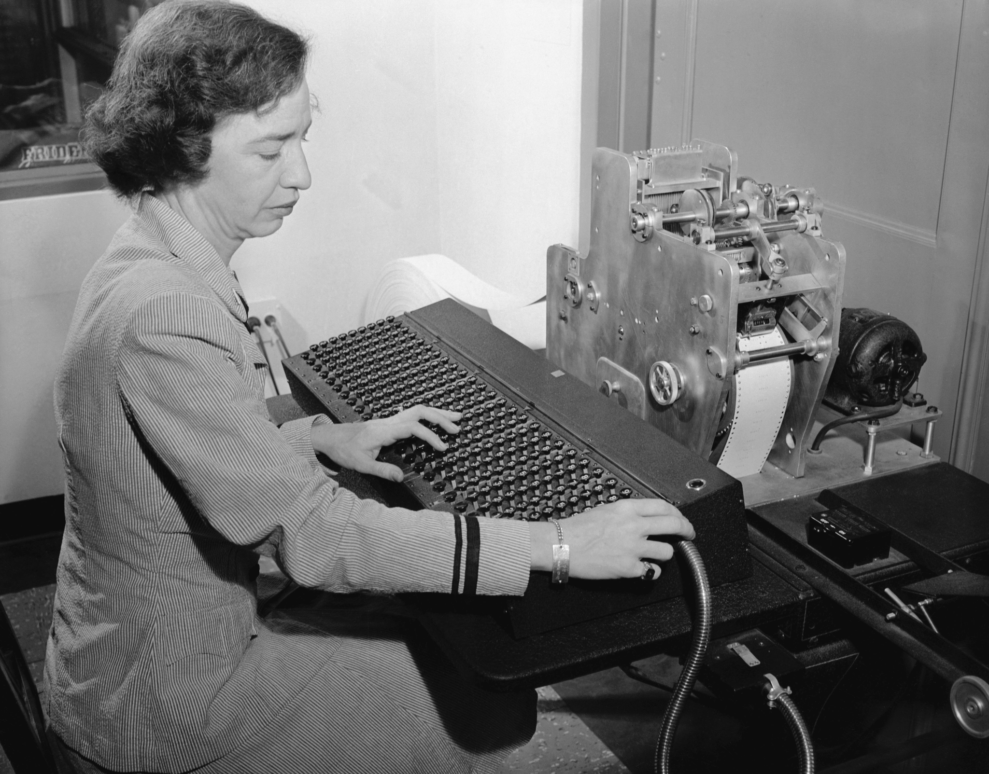
Who is Grace Hopper?
Grace Hopper: Born 1906
Early computer scientist
Navy admiral
Known for:
Inventing one of the first linkers
Theory of machine-independent programming languages
Notes:
When there is a problem in a computer program and it isn’t working, engineers often say that they need to “debug”
This word comes from a real problem engineers faced early on in the field of computer science. Computers were large, used vacuum tubes as components, and required frequent maintenance.
Sometimes, a bug would enter the machine and/or get stuck inside, causing errors. So, engineers needed to “debug” the computer.

Slide 7
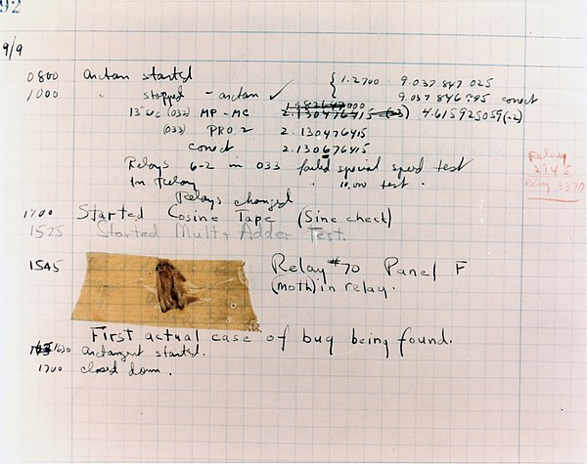
What is debugging?
A bug died inside Grace Hopper’s computer and impeded the relay operations
The term “debugging” was born
Notes:
When there is a problem in a computer program and it isn’t working, engineers often say that they need to “debug”
This word comes from a real problem engineers faced early on in the field of computer science. Computers were large, used vacuum tubes as components, and required frequent maintenance.
Sometimes, a bug would enter the machine and/or get stuck inside, causing errors. So, engineers needed to “debug” the computer.

Slide 8
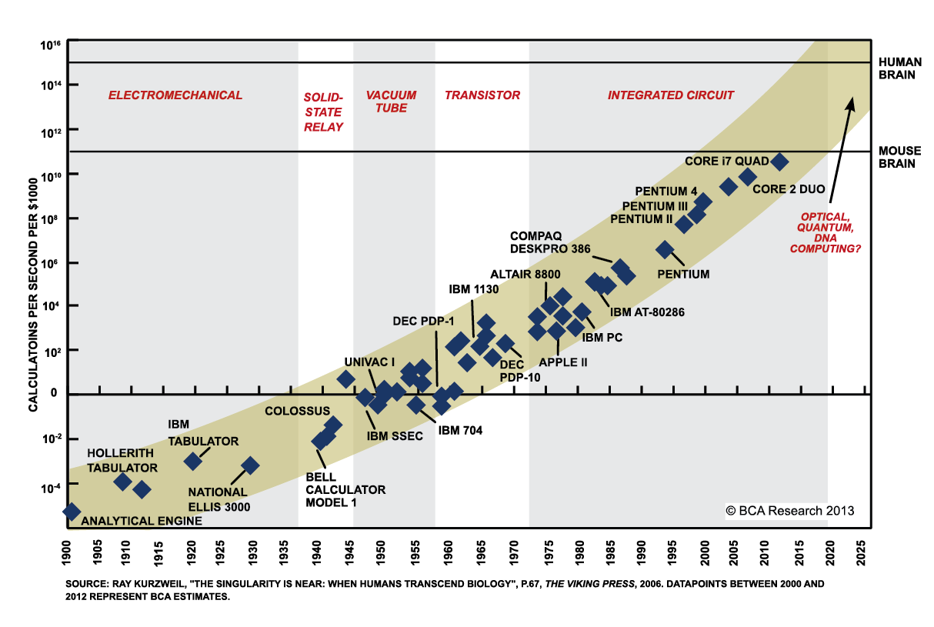
Debugging is still difficult, but luckily doesn’t involve real bugs
Today, computers are faster, store more data, and take up less space.

Slide 9
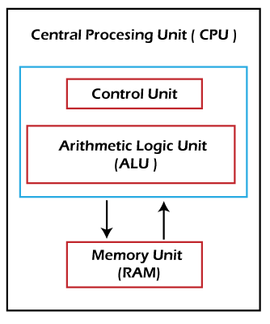
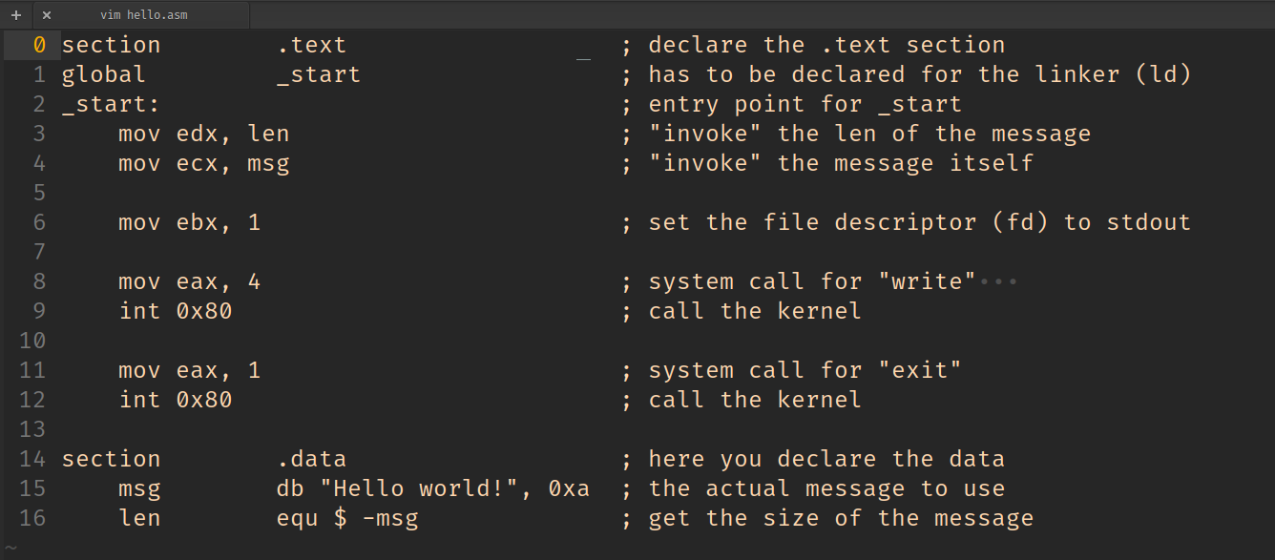

Slide 10
How to make computers faster?
Get data faster.
Access to data is limited by distance (speed of light).
Multiple tiers of cache on a chip.

Slide 11
How to make computers faster?
Get data faster.
Access to data is limited by distance (speed of light).
Multiple tiers of cache on a chip.
Computer | Human Analogy

Slide 12
How to make computers faster?
Get data faster.
Access to data is limited by distance (speed of light).
Multiple tiers of cache on a chip.
Computer | Human Analogy
L1 Cache: 1ns

Slide 13
How to make computers faster?
Get data faster.
Access to data is limited by distance (speed of light).
Multiple tiers of cache on a chip.
Computer | Human Analogy
L1 Cache: 1ns | 0.25 seconds

Slide 14
How to make computers faster?
Get data faster.
Access to data is limited by distance (speed of light).
Multiple tiers of cache on a chip.
Computer | Human Analogy
L1 Cache: 1ns | 0.25 seconds (fact just learned)

Slide 15
How to make computers faster?
Get data faster.
Access to data is limited by distance (speed of light).
Multiple tiers of cache on a chip.
Computer | Human Analogy
L1 Cache: 1ns | 0.25 seconds (fact just learned)
L3 Cache: 16ns

Slide 16
How to make computers faster?
Get data faster.
Access to data is limited by distance (speed of light).
Multiple tiers of cache on a chip.
Computer | Human Analogy
L1 Cache: 1ns | 0.25 seconds (fact just learned)
L3 Cache: 16ns | 4 seconds (fact from a month ago)

Slide 17
How to make computers faster?
Get data faster.
Access to data is limited by distance (speed of light).
Multiple tiers of cache on a chip.
Computer | Human Analogy
L1 Cache: 1ns | 0.25 seconds (fact just learned)
L3 Cache: 16ns | 4 seconds (fact from a month ago)
RAM: 100ns

Slide 18
How to make computers faster?
Get data faster.
Access to data is limited by distance (speed of light).
Multiple tiers of cache on a chip.
Computer | Human Analogy
L1 Cache: 1ns | 0.25 seconds (fact just learned)
L3 Cache: 16ns | 4 seconds (fact from a month ago)
RAM: 100ns | 25 seconds (look in a book on your desk)

Slide 19
How to make computers faster?
Get data faster.
Access to data is limited by distance (speed of light).
Multiple tiers of cache on a chip.
Computer | Human Analogy
L1 Cache: 1ns | 0.25 seconds (fact just learned)
L3 Cache: 16ns | 4 seconds (fact from a month ago)
RAM: 100ns | 25 seconds (look in a book on your desk)
SSD: 100,000ns (100us)

Slide 20
How to make computers faster?
Get data faster.
Access to data is limited by distance (speed of light).
Multiple tiers of cache on a chip.
Computer | Human Analogy
L1 Cache: 1ns | 0.25 seconds (fact just learned)
L3 Cache: 16ns | 4 seconds (fact from a month ago)
RAM: 100ns | 25 seconds (look in a book on your desk)
SSD: 100,000ns (100us) | ~7 hours (go to the library today)

Slide 21
How to make computers faster?
Get data faster.
Access to data is limited by distance (speed of light).
Multiple tiers of cache on a chip.
Computer | Human Analogy
L1 Cache: 1ns | 0.25 seconds (fact just learned)
L3 Cache: 16ns | 4 seconds (fact from a month ago)
RAM: 100ns | 25 seconds (look in a book on your desk)
SSD: 100,000ns (100us) | ~7 hours (go to the library today)
Disk: 10,000,000ns (10,000us, 10ms)

Slide 22
How to make computers faster?
Get data faster.
Access to data is limited by distance (speed of light).
Multiple tiers of cache on a chip.
Computer | Human Analogy
L1 Cache: 1ns | 0.25 seconds (fact just learned)
L3 Cache: 16ns | 4 seconds (fact from a month ago)
RAM: 100ns | 25 seconds (look in a book on your desk)
SSD: 100,000ns (100us) | ~7 hours (go to the library today)
Disk: 10,000,000ns (10,000us, 10ms) | ~29 days (Jamcoders!)

Slide 23
How to make computers faster?
Get data faster.
Access to data is limited by distance (speed of light).
Multiple tiers of cache on a chip.
Computer | Human Analogy
L1 Cache: 1ns | 0.25 seconds (fact just learned)
L3 Cache: 16ns | 4 seconds (fact from a month ago)
RAM: 100ns | 25 seconds (look in a book on your desk)
SSD: 100,000ns (100us) | ~7 hours (go to the library today)
Disk: 10,000,000ns (10,000us, 10ms) | ~29 days (Jamcoders!)
Network (JAM ↔ NYC): 70,000,000ns (70,000us, 70ms)

Slide 24
How to make computers faster?
Get data faster.
Access to data is limited by distance (speed of light).
Multiple tiers of cache on a chip.
Computer | Human Analogy
L1 Cache: 1ns | 0.25 seconds (fact just learned)
L3 Cache: 16ns | 4 seconds (fact from a month ago)
RAM: 100ns | 25 seconds (look in a book on your desk)
SSD: 100,000ns (100us) | ~7 hours (go to the library today)
Disk: 10,000,000ns (10,000us, 10ms) | ~29 days (Jamcoders!)
Network (JAM ↔ NYC): 70,000,000ns (70,000us, 70ms) | ~202 days (a year of school)

Slide 25
Why make them faster?

Slide 26
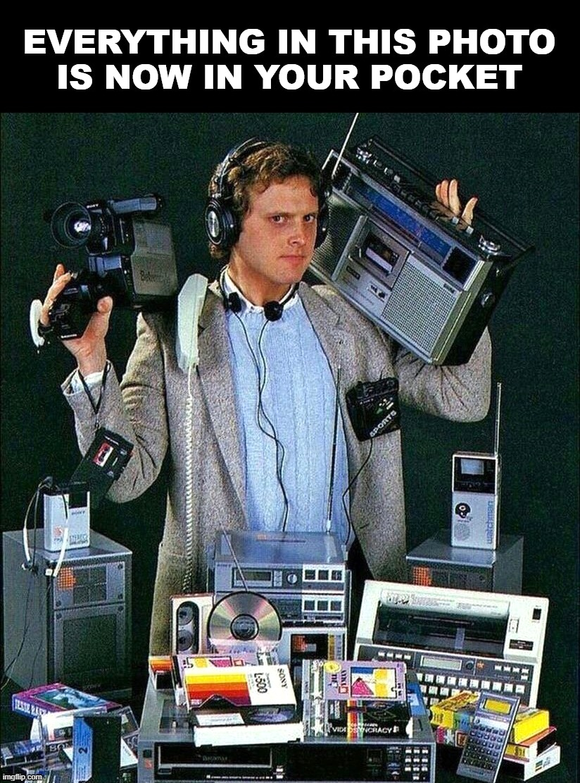

Slide 27
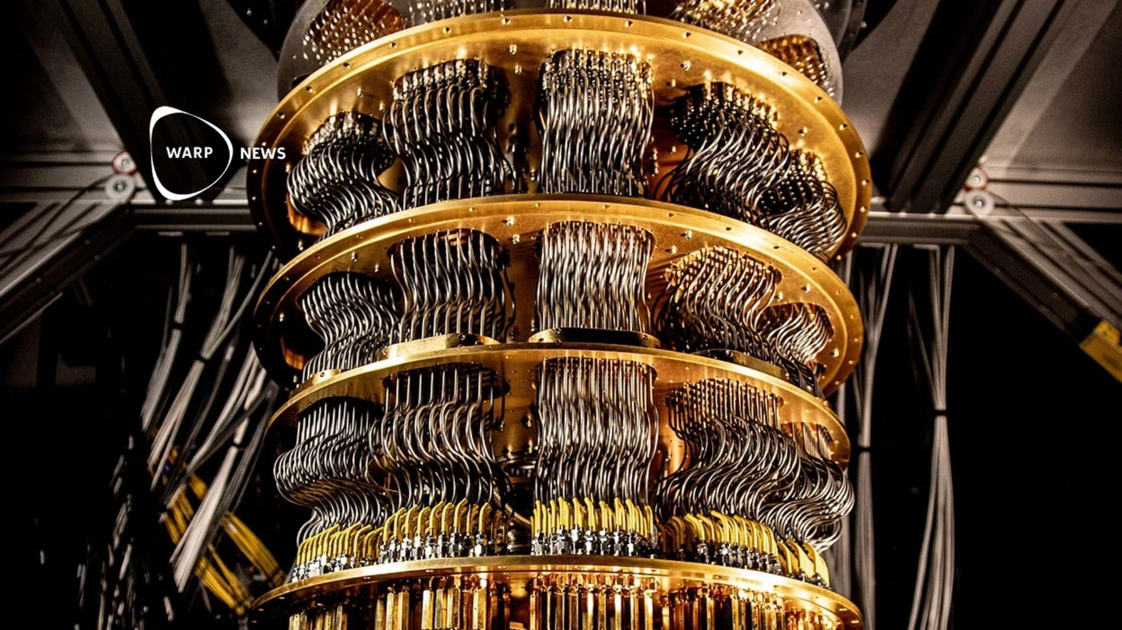
Google’s Quantum Computer!

Slide 28
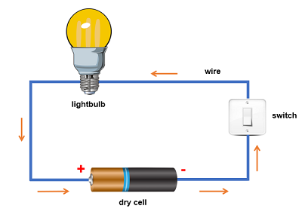
What is voltage?
Electric potential difference per unit charge between two points in a circuit’s electric field.
_
+
The battery supplies voltage, causing an energy imbalance to exist between the + and -
This causes current (electrons or ions) to flow

Slide 29
What is current? Resistance?
Electrical current is a stream of charged particles, such as electrons or ions, moving through an electrical conductor.
Resistance restricts the flow of current.

Slide 30
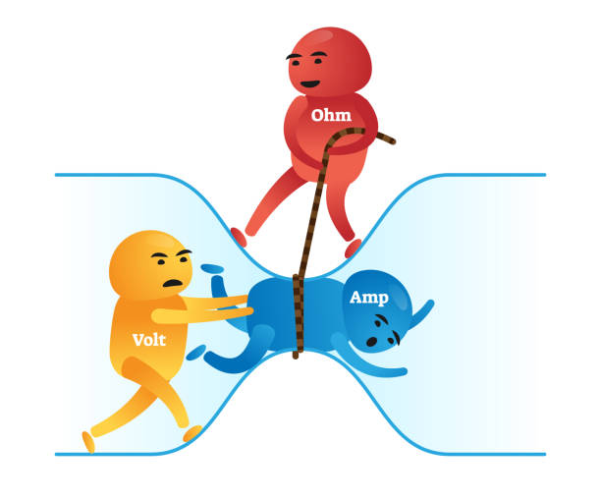
Ohm’s Law
Resistance opposes electron flow
Ohm’s Law captures the relationship between:
Current (I)
Voltage (V)
Resistance (R)
V = IR
Current is flowing through wire
Voltage is causing current to flow

Slide 31
Circuit Components
Wires
Resistors
Capacitors
TransistorsSwitches
OR, AND, NOR, and NOT gates
The list goes on…

Slide 32
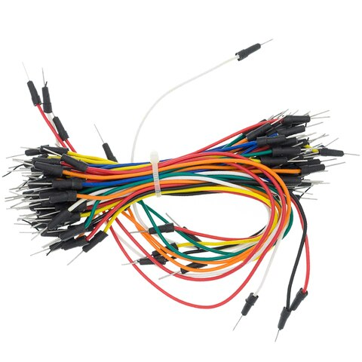
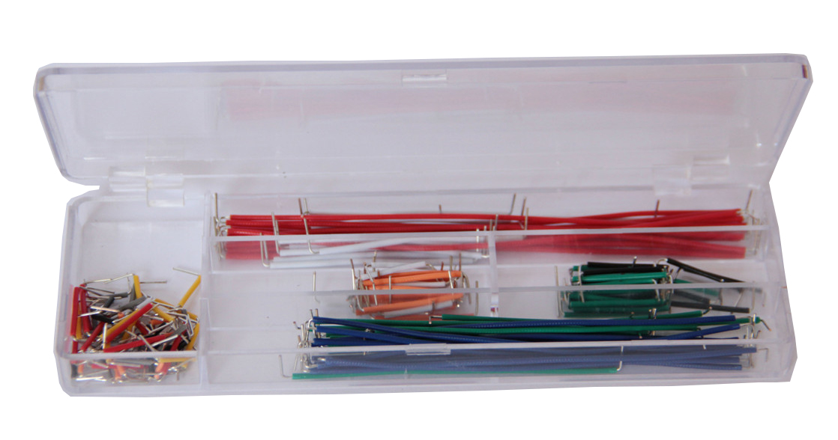
Wires
I know you know what wires are, here are some photos of the ones we’re using:
The metal ends enter the breadboard and Arduino pin holes

Slide 33
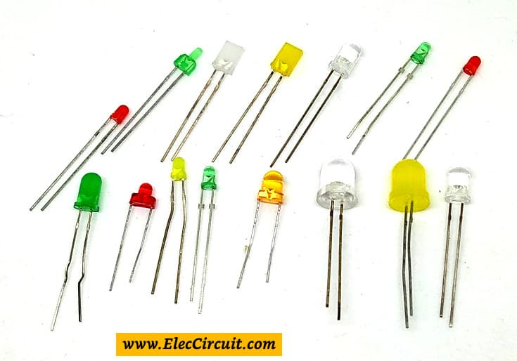
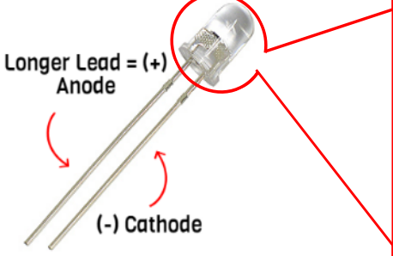
LED Lightbulbs

Slide 34
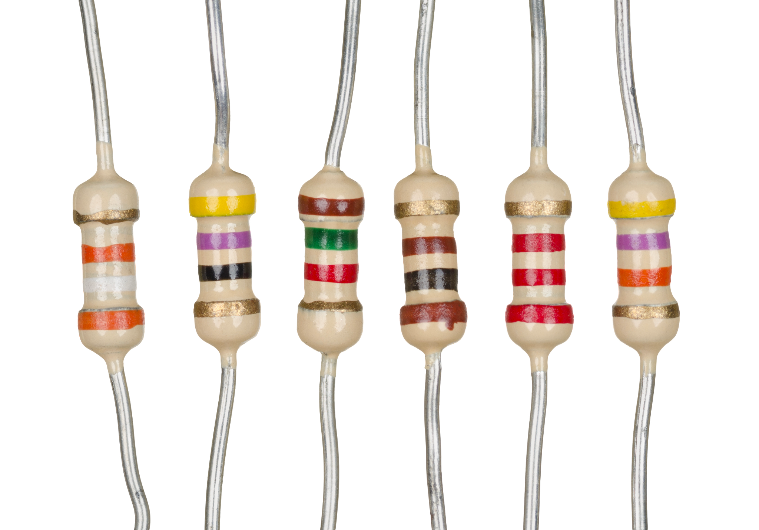
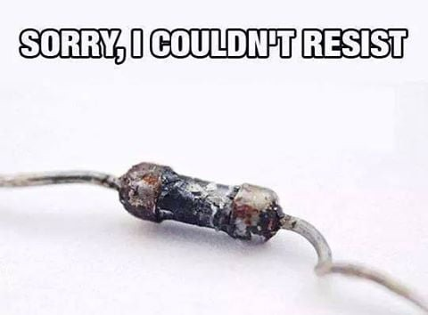
Resistors
Resistors provide resistance to electrical current.
They are often needed to regulate the current and voltage in a circuit.
(You’ll be using ~220 Ohms)

Slide 35
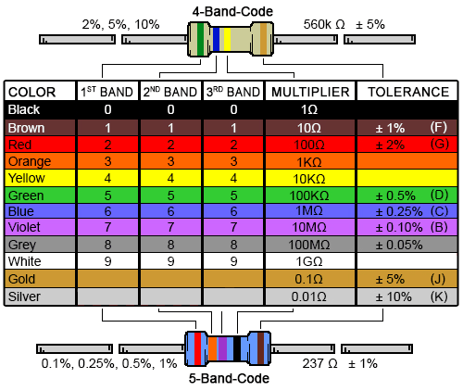
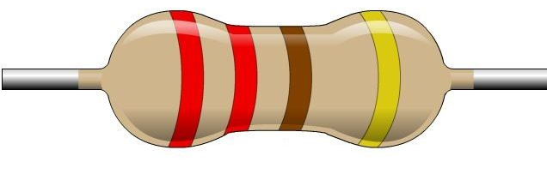
Resistors
You’ll be using ~220 Ohms

Slide 36
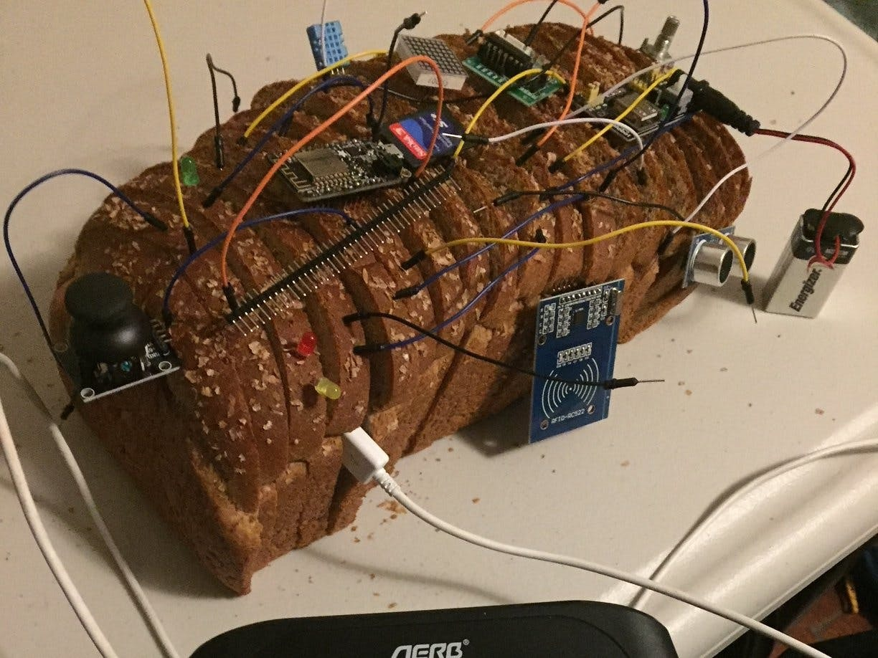

Slide 37
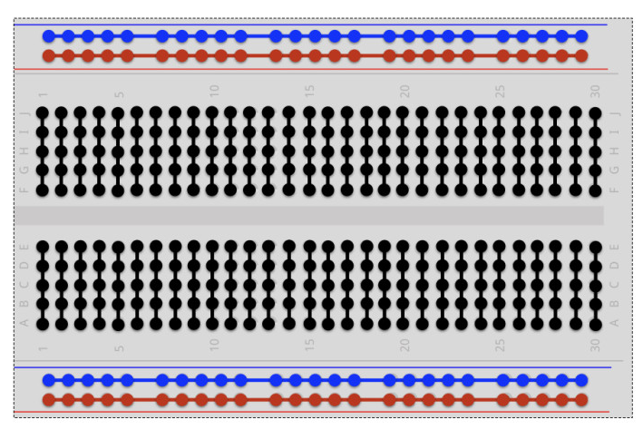
Breadboard
Breadboards are used to organize and connect circuit elements.

Slide 38
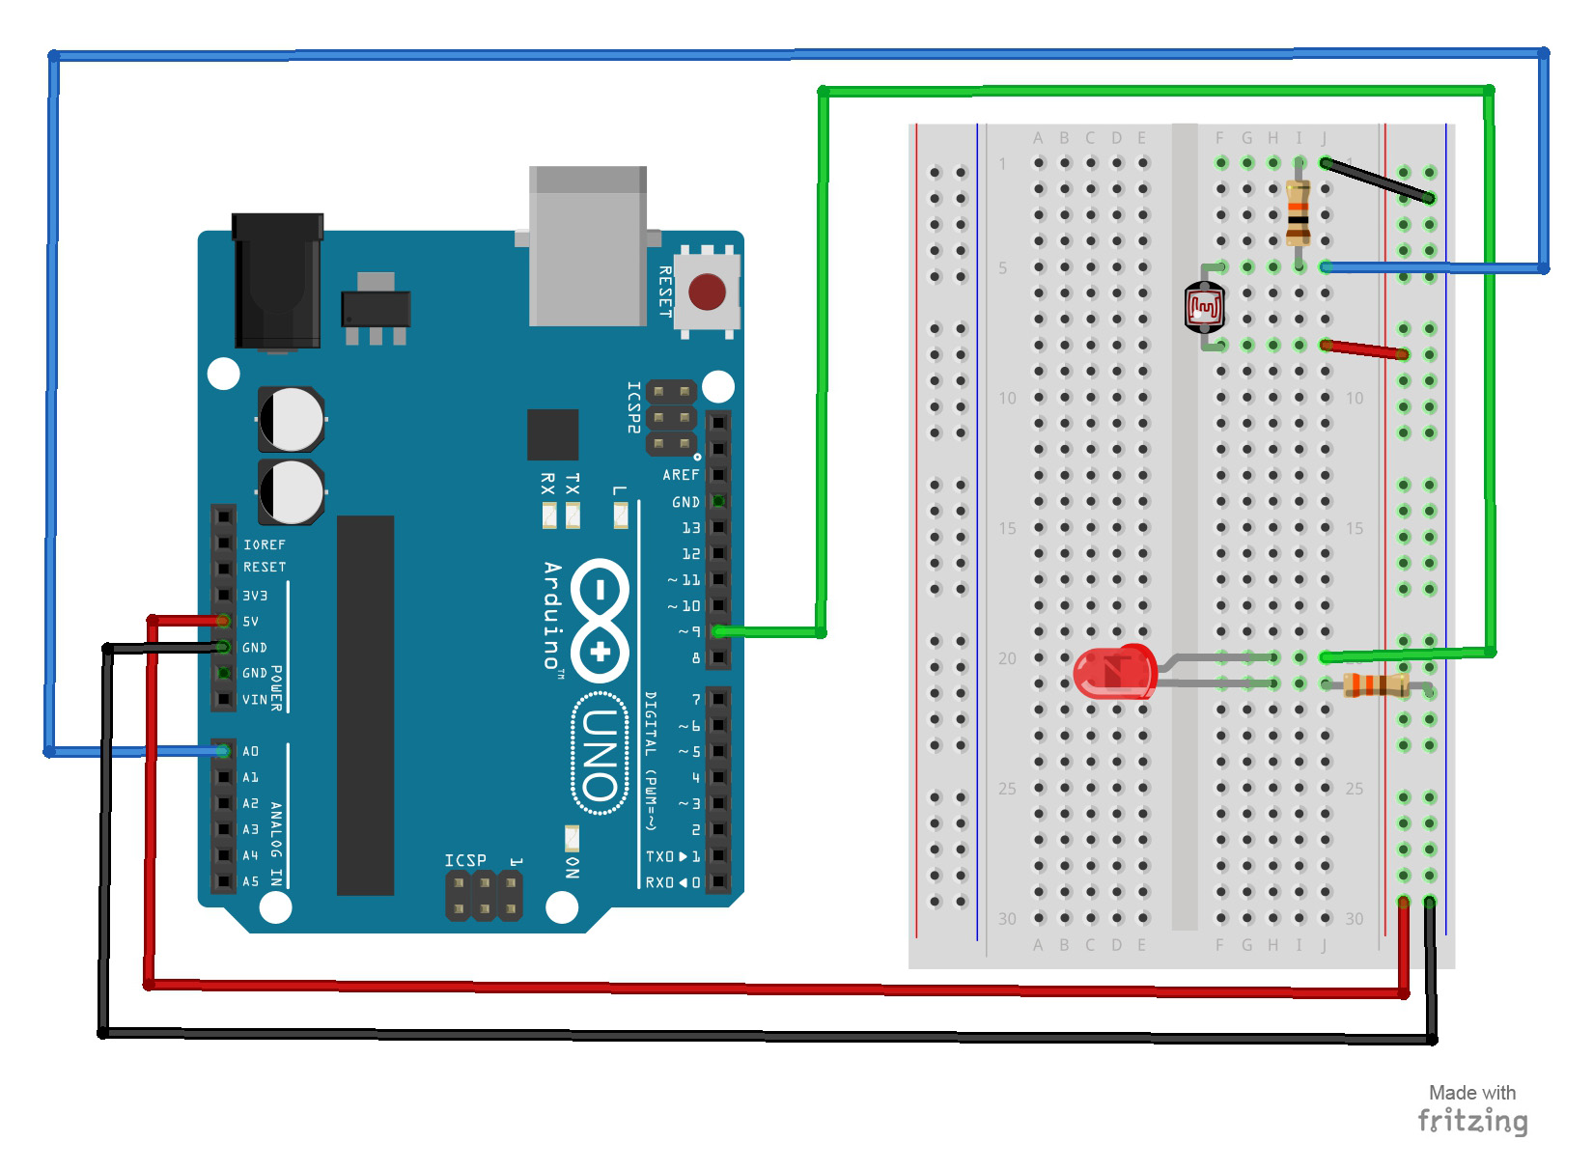
Arduino Chip
Breadboard

Slide 39
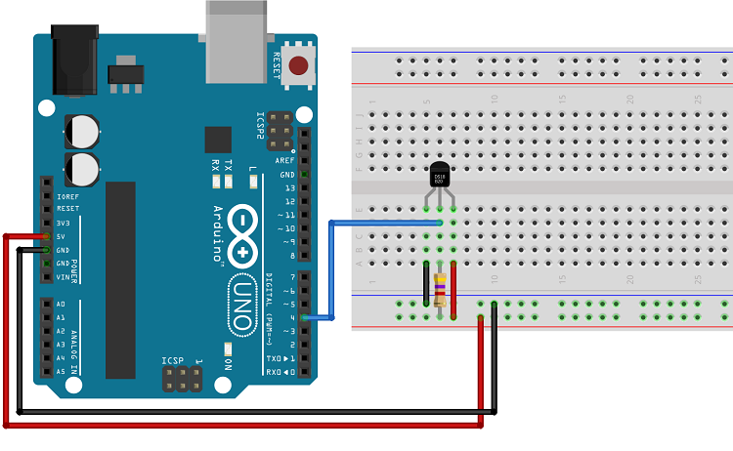
Power
(5V or 3.3V)
Ground (GND)
Pins, here pin 4 is in use

Slide 40
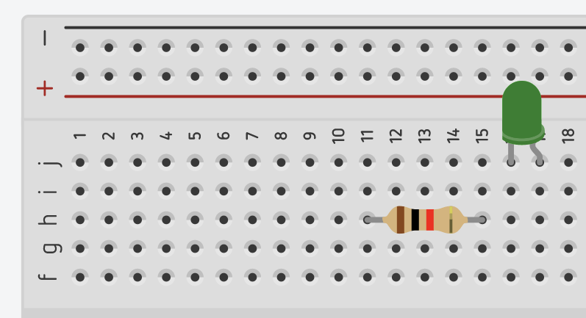
Are the resistor and the lightbulb connected?

Slide 41
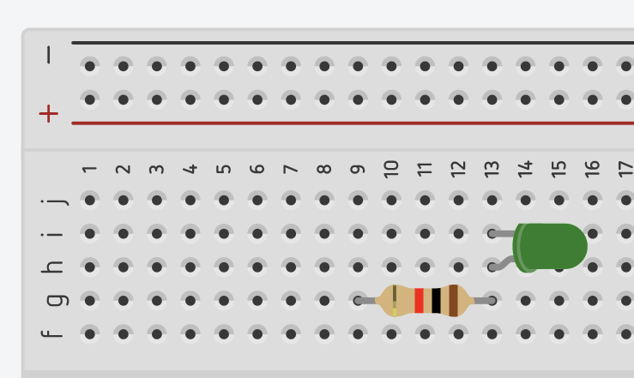
What about now? Is there anything wrong with this connection?

Slide 42
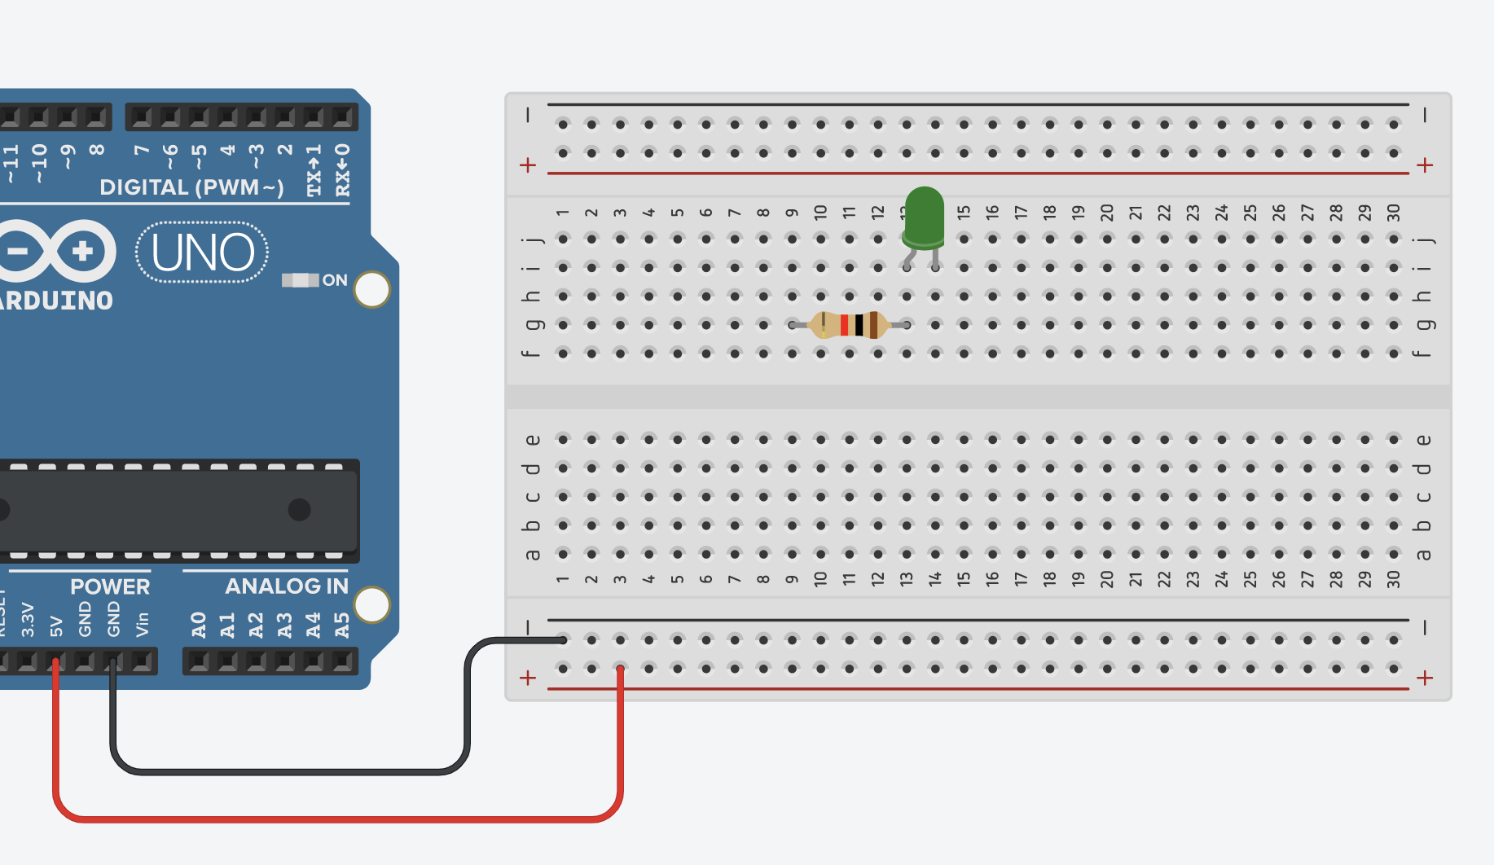
What about now? Is there anything wrong with this connection?

Slide 43
Now it’s your turn to make some circuits!

Slide 44
Group 1: Shechanyah, Kalani, Joelle, Ayeisha, Zyeka
Group 2: Nyla, Kayleigh, Austin, Sean, Rebekah, Oksana
Group 3: Aiden, Naandi, Jozanne, Yemesi, Gisele
Group 4: Antwaun, Alyssa, Rishi, Kairo-Alexis, Tariq
Group 5: Robert, Chenelle, Daniel, Tessanne, Brianna
Group 6: Aprille, Oscar, Kamali, Kara-Lee, Kayla
Group 7: Jadon, Aneika, Kejaaun, Jemila, Tiandra, Damir
Group 8: Kiana, Zephan, Janic, Orett, Larissa, Cavier
Group 9: Neveno, Malique, Daniela, Gabrielle, Richaiya, Raheem

Slide 45
What’s in Your Kit? → Call a TA if you’re missing things
1 Arduino Uno
1 Single-Colour LED 💡
1 RGB LED 🌈
3 Resistors (100-330 Ohms)
1 Breadboard 🍞
Wiressss

Slide 46
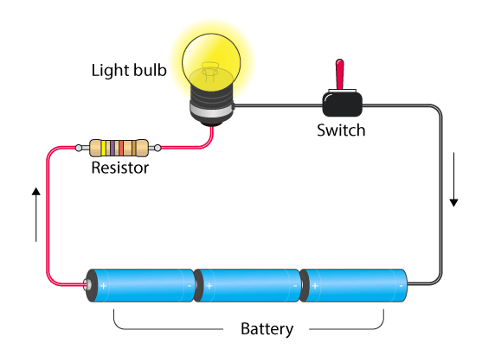

Let’s Make a Simple Light Circuit!

Slide 47
Let’s connect our circuit board to +/- voltage:

Slide 48
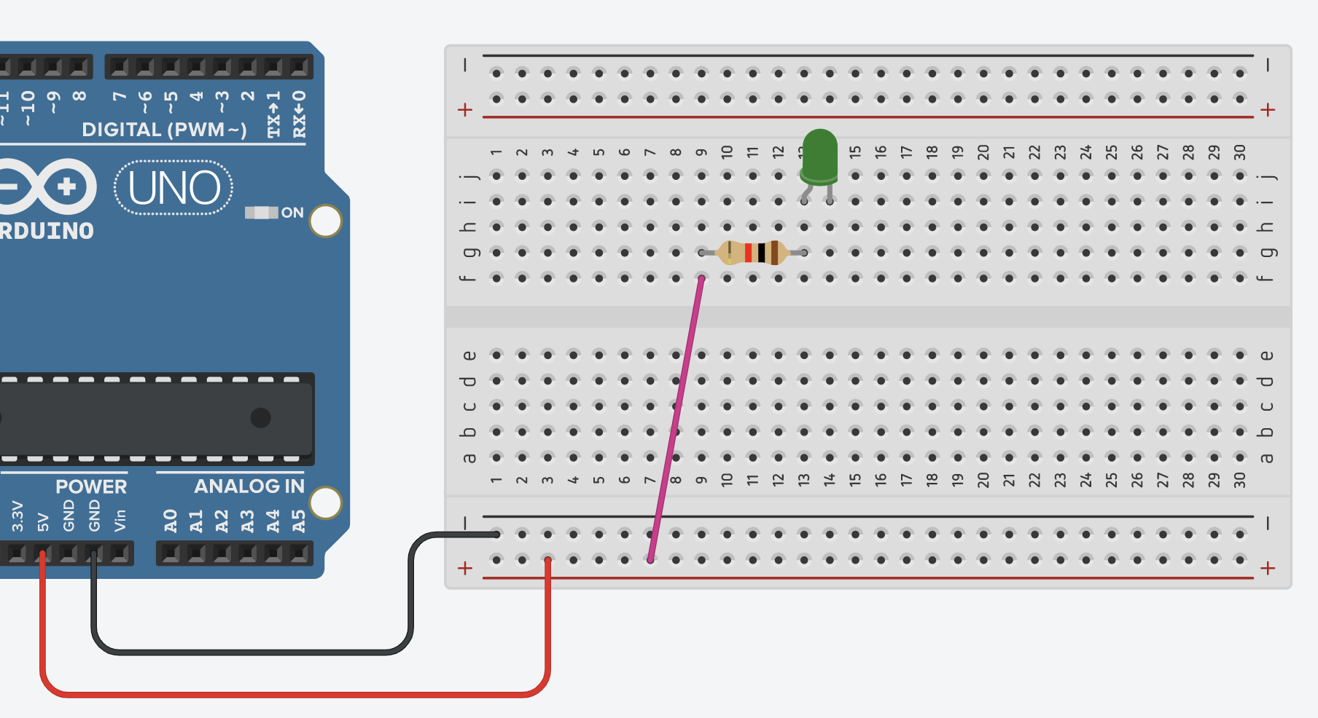
Now let’s connect the positive voltage to the resistor:

Slide 49
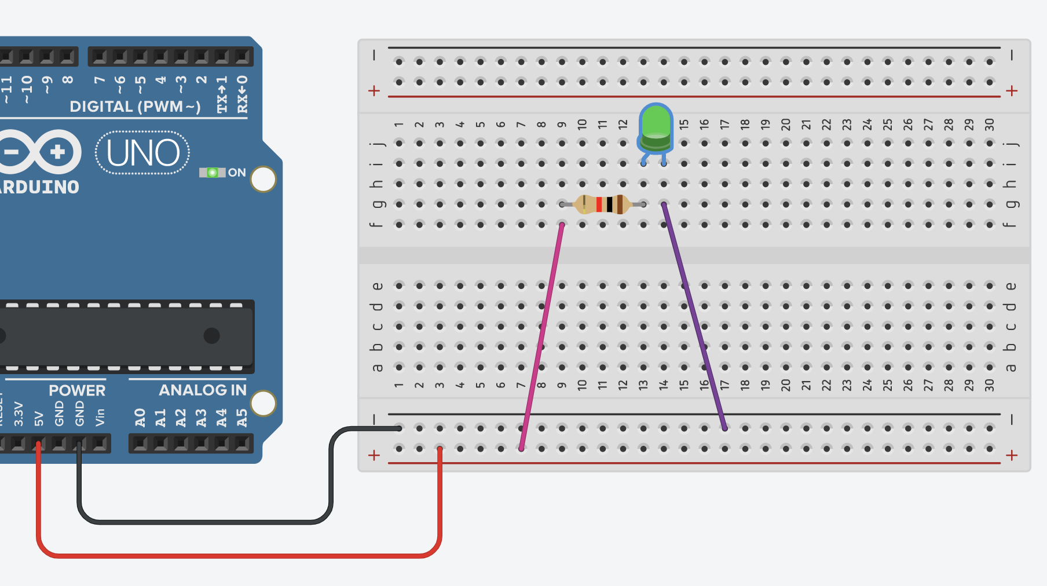
Now let’s connect the negative voltage to the lightbulb:
Now, raise your hand and I will plug in the Arduino microcontroller!

Slide 50
But what if I want it to blink?

Slide 51
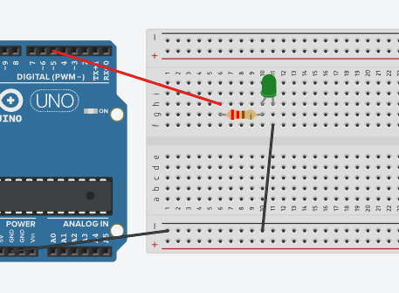
Giving our Circuit Personality
Move your positive voltage to pin 5 on the Arduino and open the following file and run it:
blink_led.ino

Slide 52
Image of Arduino ui - connect to board

Slide 53
Arduino chips run code which controls the voltage and current applied via wires into our circuit

Slide 54
But what if I want to make a light switch?

Slide 55
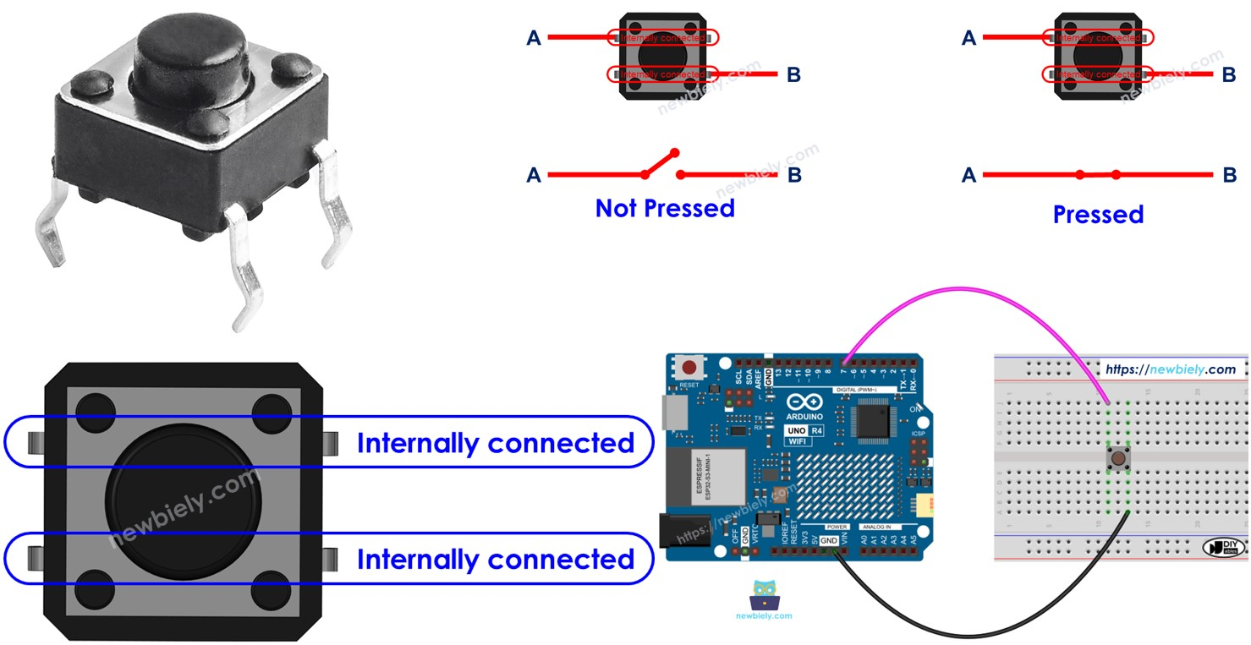

Slide 56
Try to make a circuit that turns an LED on and off with a button. Try it on your own first, but don’t be afraid to ask for help!

Slide 57
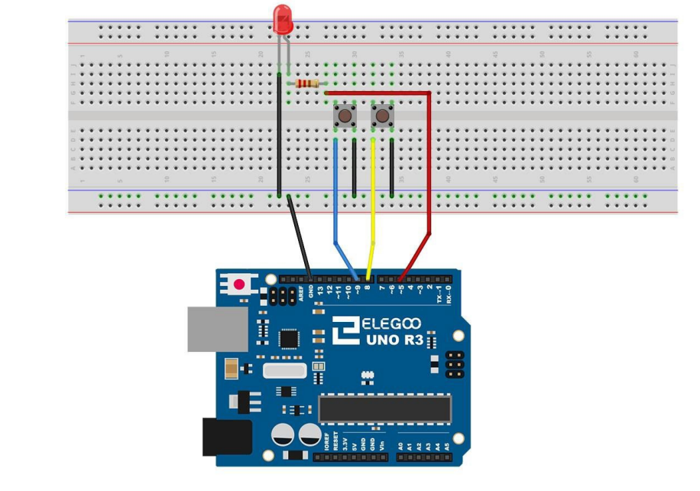
Open and run the following file when finished:
LED_buttons.ino
Make sure to get the pin numbers right!

Slide 58
But what if I want to have a colorful light?

Slide 59
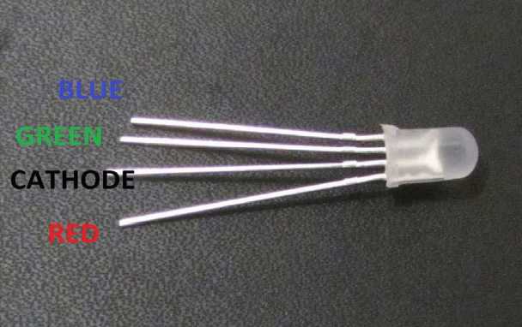

Slide 60
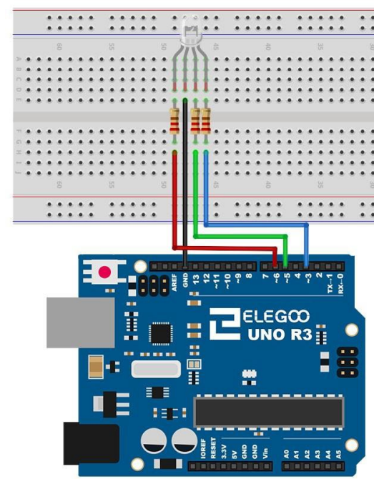
Raise your hand when you have built this circuit and know the current (in Amps) supplied to each RGB pin!!
V = IR
5v supplied by each digital pin

Slide 61
Now put it together!
Make a circuit that uses TWO buttons to control the colour of an RGB LED.
Use pins 8 and 9 for the buttons
RED -> 3, BLUE -> 6, GREEN -> 5
Remember your resistors!!!!
Call a TA when you’re done!

Slide 62
Open rbg_buttons.ino

Slide 63
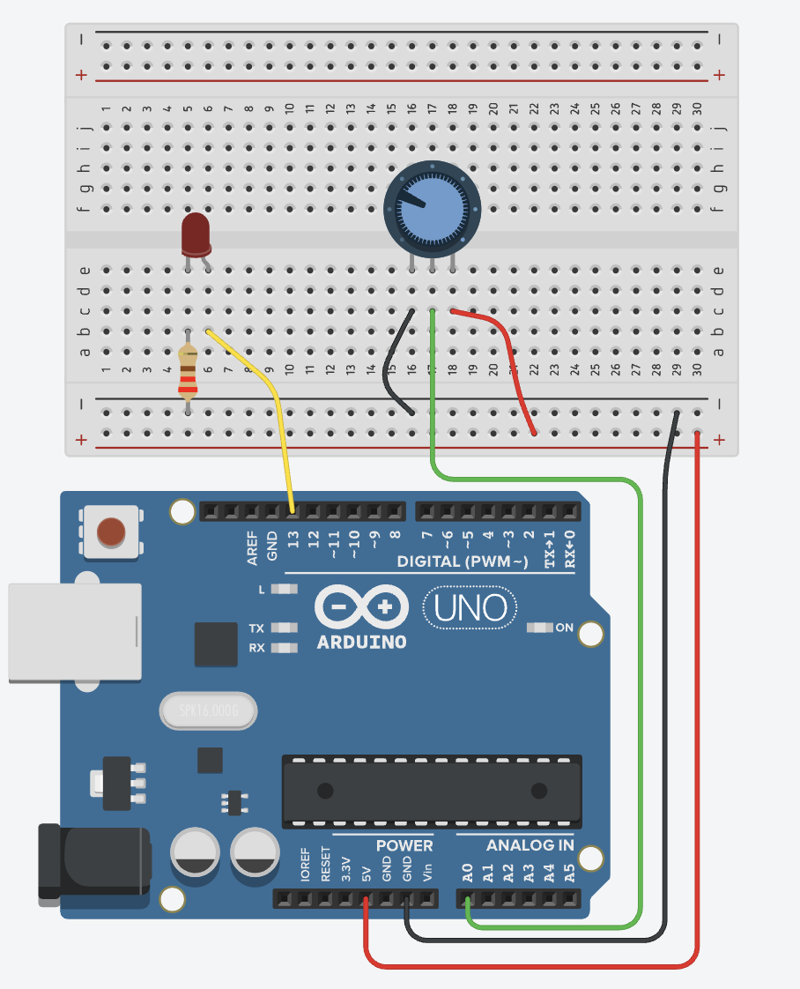
Challenge Problem! Diming light with potentiometer (analog input)
Open led_dim.ino

